Slide 1

Git and Github
Abdullah Saihan
Artificial Intelligence Engineer

Slide 2
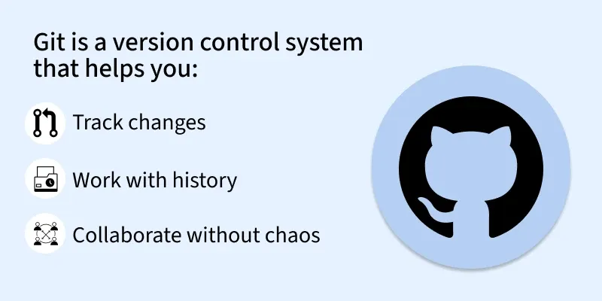

Slide 3
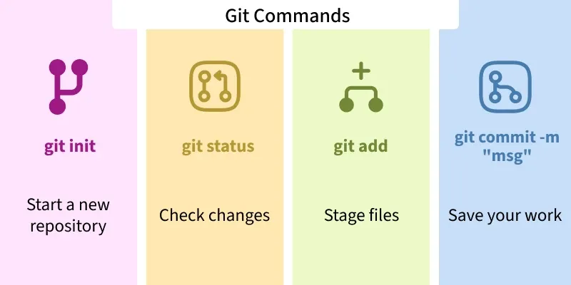

Slide 4
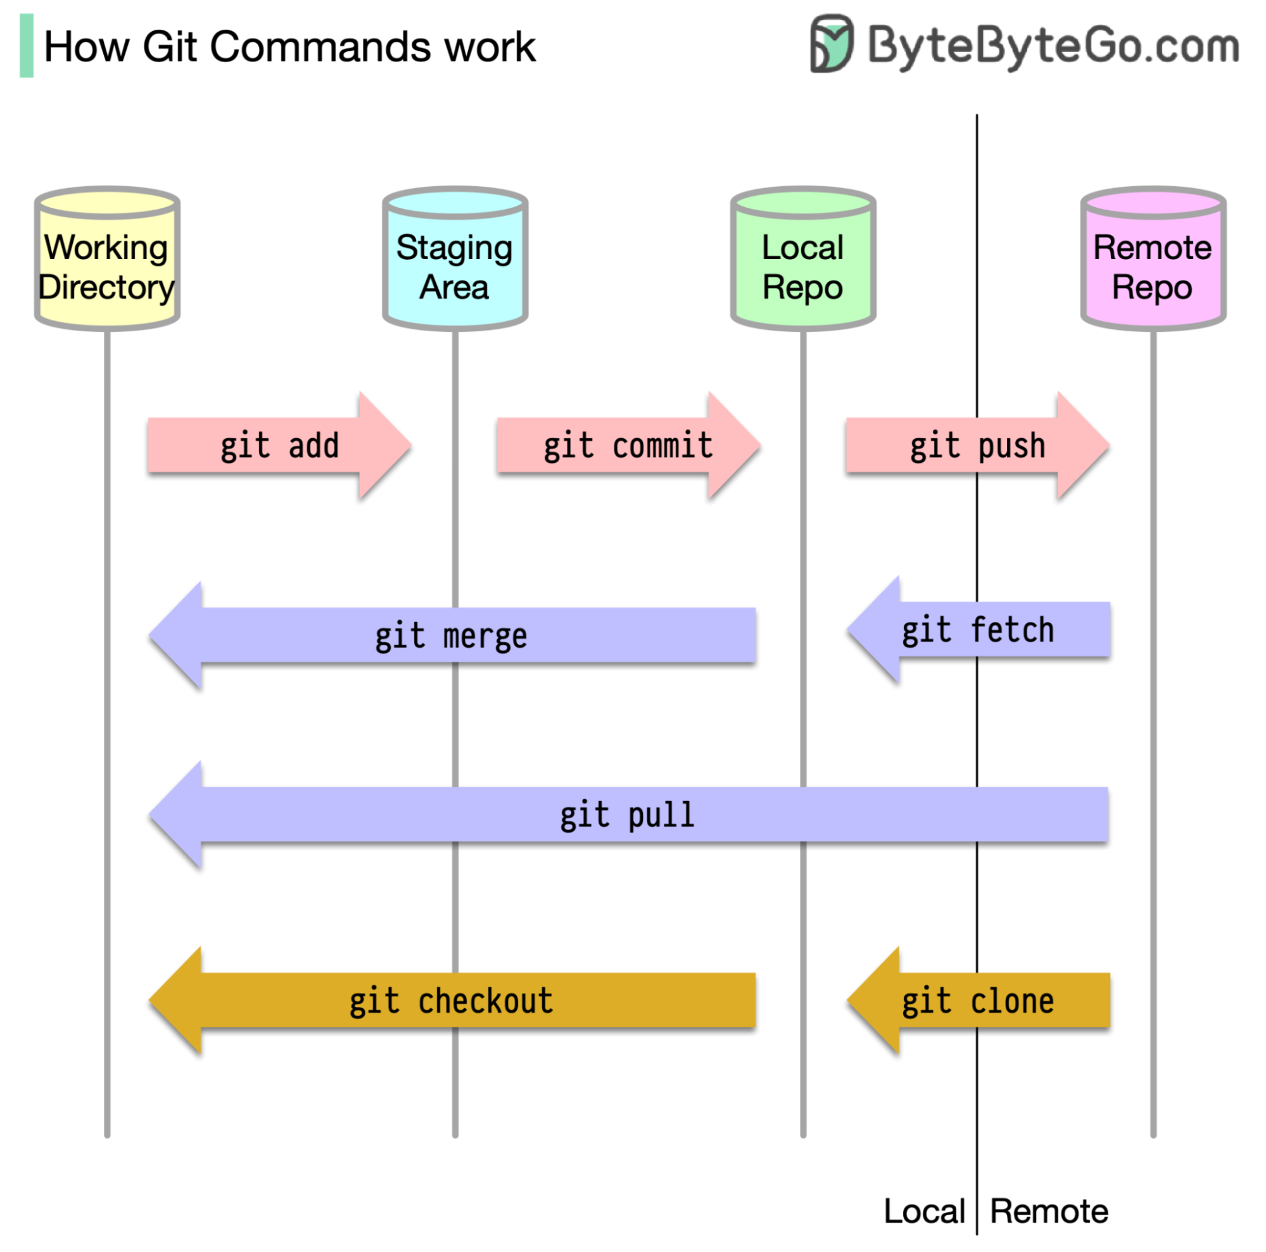

Slide 5
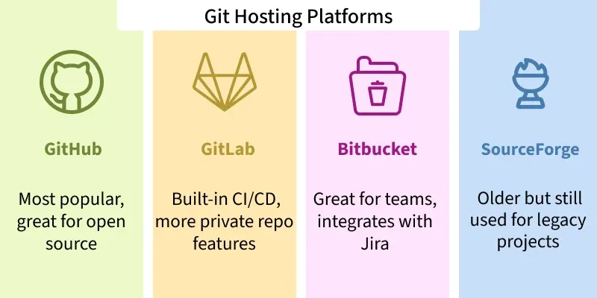

Slide 6
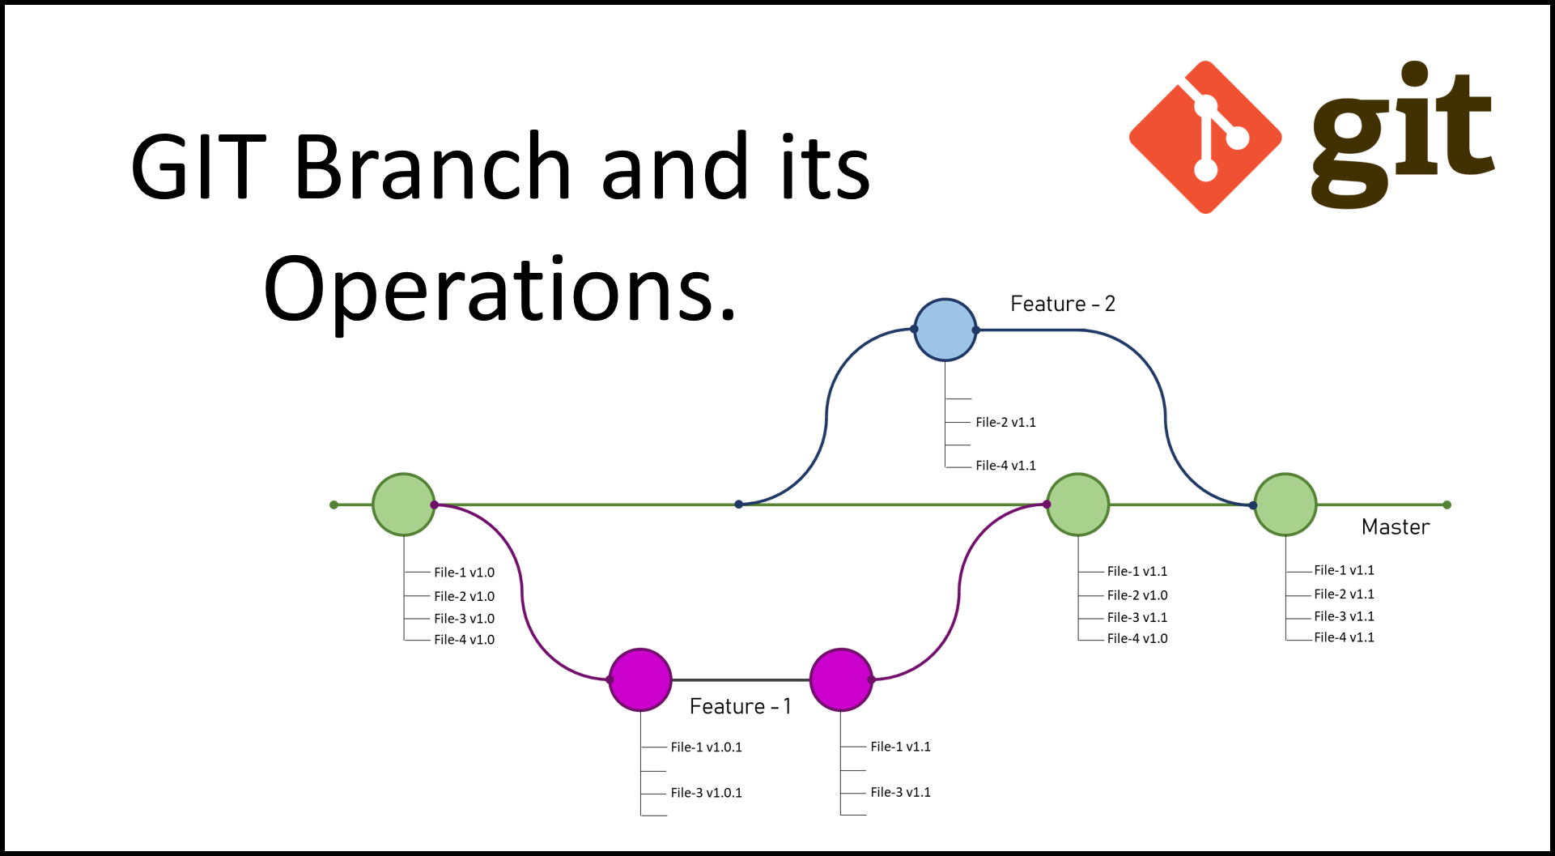
Git Branch

Slide 7
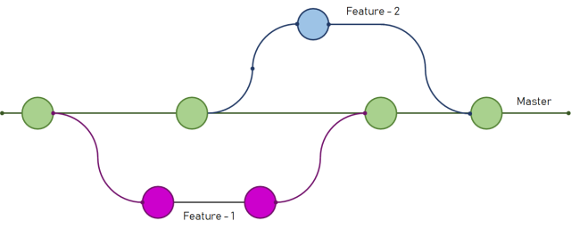
Git Branch

Slide 8
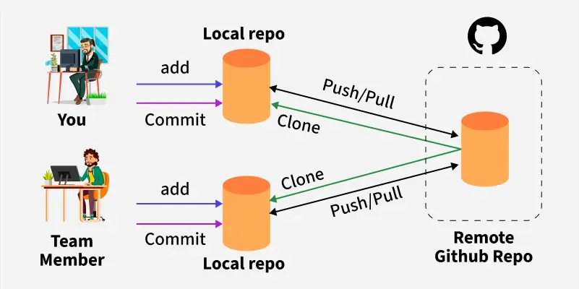

Slide 9


Slide 10
Resources
A Simple Visual Git Tutorial
Git School: Visual Git (Simulator/Playground))
Learn Git Branching (Simulator/Playground)

